Slide 1
Network Analysis on Post Trade data: variation in topology and stability of Central nodes and Scale-free Behaviour over time
Monte Titoli Data Science
Milan, 03 September 2021

Slide 2
Agenda
The aim of the study is the construction of Social Networks from Post trade Settlement Instructions from TARGET2-Securities (T2S).
The study can be divided in two main Network constructions:
Monthly cumulative and noncumulative Networks:
The identication over time of a Scale-free behaviour
Definition of a ranking for the most central
Networks resiliency analysis is performed using random and targeted attacks.
Daily Networks:
Two Case-Studies of disruptive events:
COVID19
BTP Italia and BTP Futura emissions

Slide 3
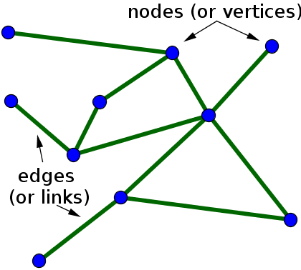
Introduction to Network Analysis
Network Analysis is a set of integrated techniques to depict relations among actors in order to analyze the social structures.
Network analysis is based on Graph theory.
A Graph is composed by:
Nodes: representing agents
Links: representing the relationship between two agents
Potentiality:
NA can be used in various fields: Sociology, Economics, Geography, History, Biology and Social Networks
NA is able to simplify complex systems

Slide 4
Data Pre-processing
Deli | Rece | Sett Status | financial instr | ETF indicator | Amt pend | Amount
Net Venture | Monte Titoli | S | Corp. Bonds | 0 | 10000 | 10000
Date range from May 2018 to end of July 2021
Datasets aggregated based on:
Company couple (deli – rece)
Financial Instrument type: 'Corp. Bonds and similar', 'Government Bonds’, 'Funds', 'Shares and similar', ‘ETF’, 'Other’.
Settlement Status: Settled (S) or Failed (N)
Free of payment instructions have been excluded
Graph representation:
Node: Company
Edge:
Directed: from Deli to Rece
Weighted: aggregated Amount Countervalue
From Financial Instrument and Settlement Status groups multiple graphs are obtained

Slide 5
Monthly Analysis
Definition of a ranking for the most central nodes
The identication over time of a Scale-free behaviour
Networks resiliency analysis is performed using random and targeted attacks

Slide 6
Monthly Cumulative vs Monthly non-cumulative Networks
Monthly Cumulative
Monthly non-cumulative
Months are not independent; each network are based on the past.
It preserve the temporal behavior of the data
Simulate the adding of new nodes
Months are independent; each network in each month is different
Node distribution is not growing and each months
Node distribution is separated over time

Slide 7
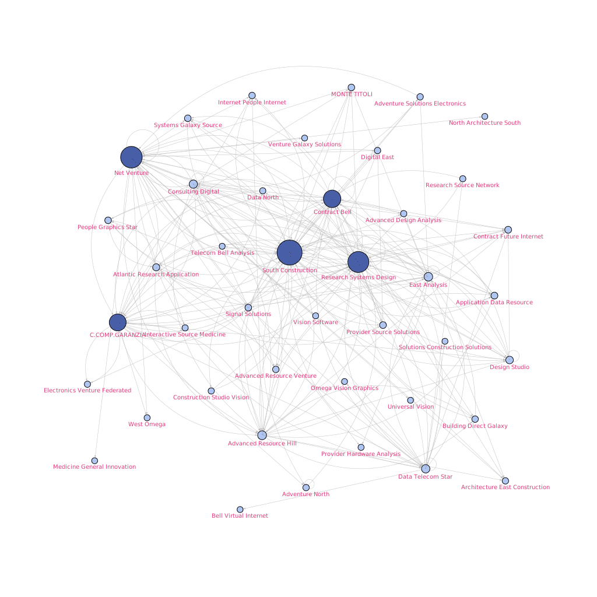
Cumulative ETF_N over time growing
Representation of cumulative ETF_N networks over time
Each month the number of nodes and edges are increasing
Central Nodes are getting bigger

Slide 8
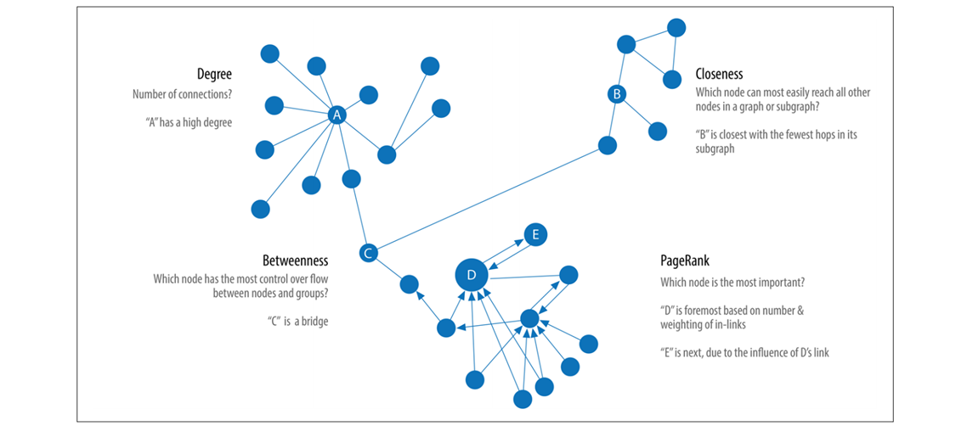
Centrality
Centrality is a measure that helps identifying the most influential nodes in a social network.
Different techniques have been applied for the computation of the most Central nodes: Degree Centrality, Betweenness Centrality, Closeness Centrality, Eigenvector Centrality, PageRank Centrality.
For simplicity purpose, only PageRank and Betweenness centrality will be presented
These techniques help in obtaining a rank of the nodes.

Slide 9
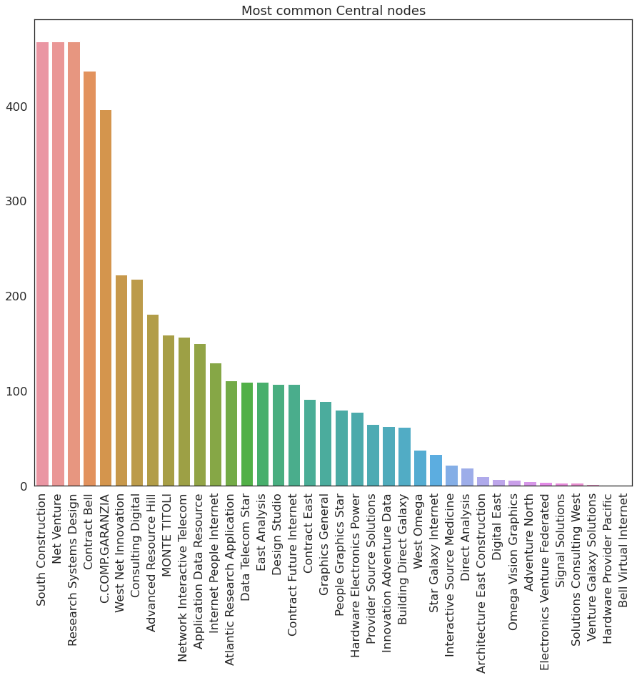
Most common Central Nodes - cumulative
South Construction, Net Venture, Research System Design are nodes that appear most frequently in the top-10 ranking of most Central nodes with a recurrency number close to 400
Contract Bel, CC&G, West Net Innovation are nodes that appear most frequently in the top-10 ranking of most Central nodes with a recurrency number close to 200

Slide 10
Central node Ranking – ETF_S cumulative
Top3: South Construction, COMP.GARANZIA, Net Venture, are in the same rank for all the period
Couple (South Construction, COMP.GARANZIA) and (Advanced Resource Hill, Research Systems Design) continuously switching position
Last position are more variables
Top3 are in the same rank for all the period.
Last position are more variables

Slide 11
Central node Ranking – ETF_N cumulative
Top4: South Construction, Net Venture, Contract Bell, C.COMP.GARANZIA and are in the same rank for all the period
Last position are more variables
Top3: Net Venture, South Construction, Contract Bell are in the same rank for all the period.
Last position are more variables

Slide 12
Central node Ranking – Funds_S cumulative
Top3: CC&G, South Construction, Net Venture are in the same rank for all the period
Couple (CC&G, South Construction) and a bit (Advanced Resource Hill, Research System Design) continuously switching position
Last position are more variables
Top3: Net Venture, Monte Titoli and South Construction
MT stated as 8th to come 2nd at the end

Slide 13
Central node Ranking – Funds_N cumulative
Top3: South Construction, Net Venture, Contract Bell are in the same rank for all the period
Couple (CC&G, Advance Resource Hill) first months are continuously switching position
Top3: Net Venture, Construction, COMP.GARANZIA
As time passing, networks are getting bigger and seem to present more a scale-free behavior.

Slide 14
Central node Ranking – Shares_S cumulative
Top3: CC&G, South Construction, Net Venture for the major part of the period
West Net Innovation in the period started from last ranks to the reach 3rd place
Top4: Monte Titoli, South Construction, Net Venture

Slide 15
Central node Ranking - Shares_N cumulative
Top3: South Construction, Research System Design, CC&G
Last position are more unstable
Top3: Net Venture, South Construction, Contract Bell

Slide 16
Central node Ranking – Corp. Bonds_S cumulative
Top4
Top3:

Slide 17
Central node Ranking - Corp. Bonds_N cumulative
Top3:
Top3:

Slide 18
Central node Ranking - Gov. Bonds_S cumulative
Top3:
Top3:

Slide 19
Central node Ranking - Gov. Bonds_N cumulative
Top3:
Top3:

Slide 20
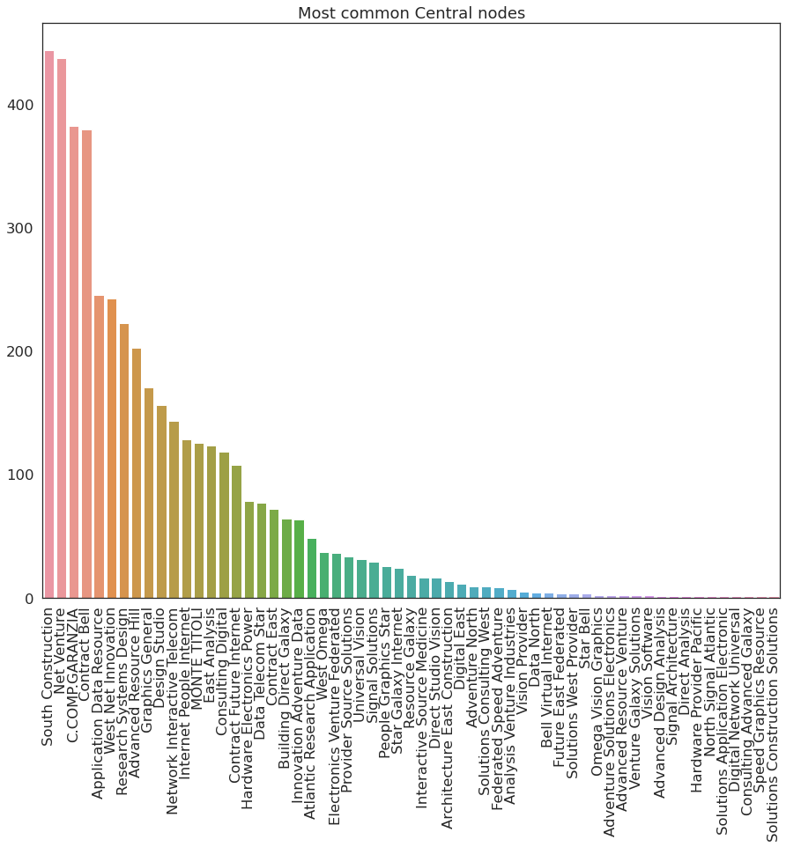
Most common Central Nodes - monthly
South Construction, Net Venture, CC&G are nodes that appear most frequently in the top-10 ranking of most Central nodes with a recurrency number close to 400
Contract Bell, Application Data Resource and West Net Innovation are nodes that appear most frequently in the top-10 ranking of most Central nodes with a recurrency number close to 200

Slide 21
Central node Ranking – ETF_S monthly
Top3:
Top3:

Slide 22
Central node Ranking – ETF_N monthly
Top3:
Top3:

Slide 23
Central node Ranking – Shares_S monthly
Top3:
Top3:

Slide 24
Central node Ranking – Share_N monthly
Top3:
Top3:

Slide 25
Central node Ranking – Funds_S cumulative
Top3:
Top3:

Slide 26
Central node Ranking – Funds_N monthly
Top3:
Top3:

Slide 27
Central node Ranking – Corp. Bonds_S monthly
Top3:
Top3:

Slide 28
Central node Ranking – Corp. Bonds_N monthly

Slide 29
Central node Ranking – Gov. Bonds_S monthly
Top3:
Top3:

Slide 30
Central node Ranking – Gov. Bonds_N monthly
Top3:
Top3:

Slide 31
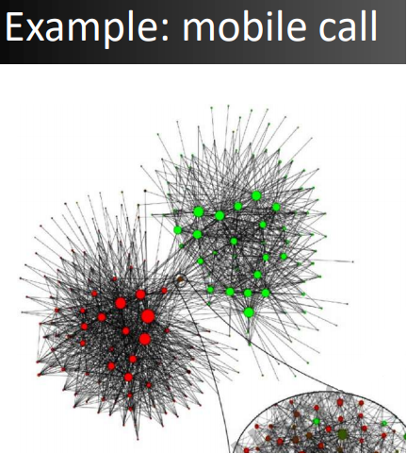
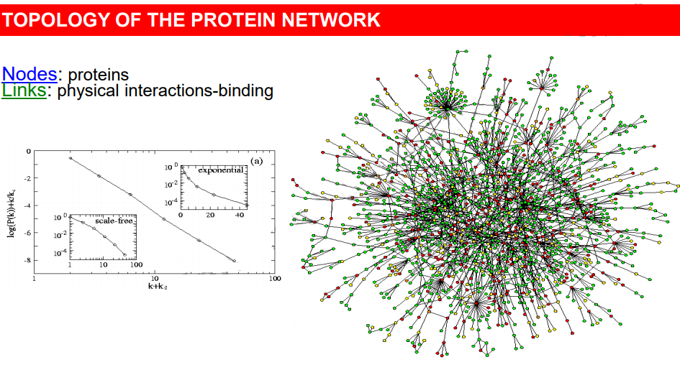
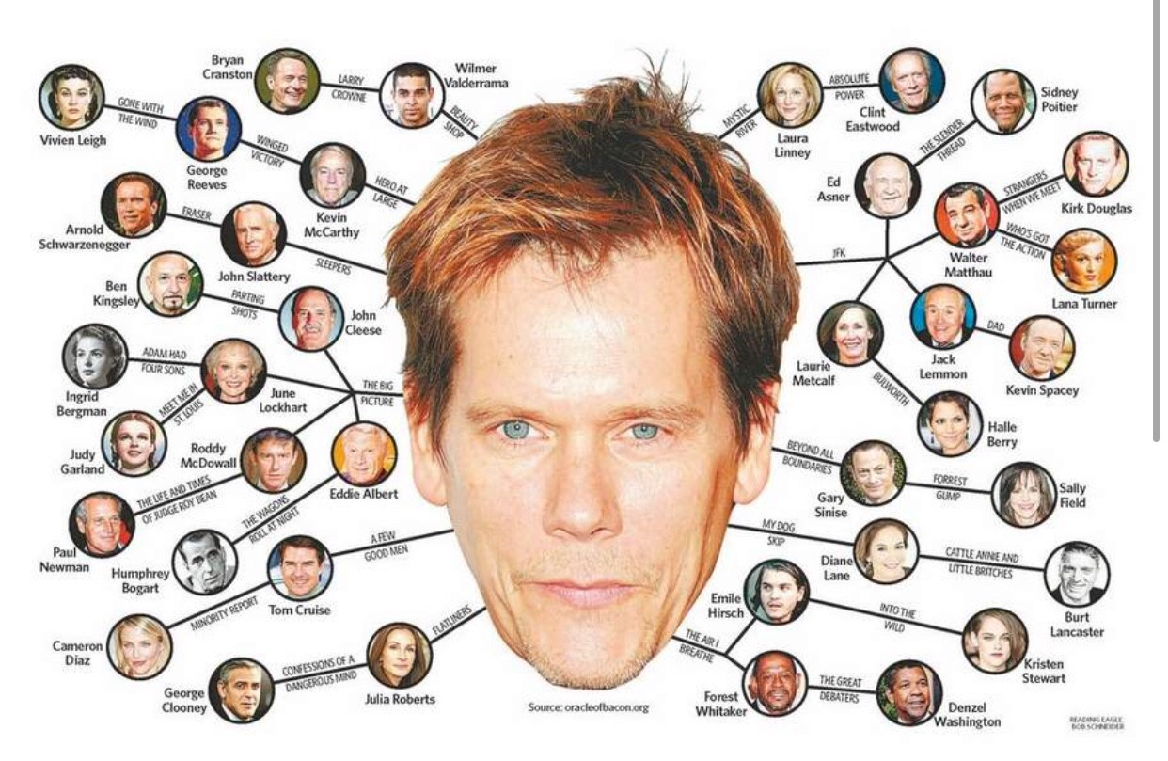
Scale-free networks – Introduction (1/2)
A lot of Social Networks are Scale-Free (World Wide Web, Facebook, Biology etc.)
Small-world theory where networks are characterized by short path-lengths:
Six degrees of separation of separations
HUBS allow connection between peripheral nodes
Six degrees of separation of separations from Kevin Bacon

Slide 32
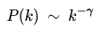
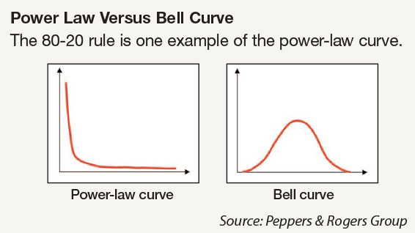
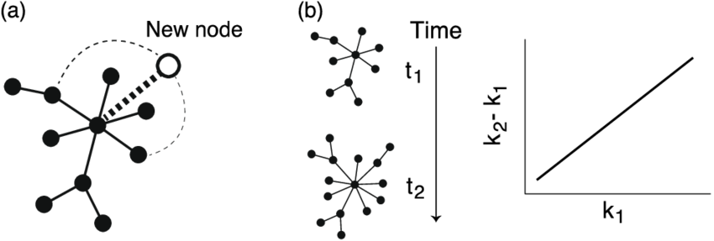
Scale-free networks – Introduction (2/2)
Scale free networks follow Power law distribution
Properties:
Growth: over an extended period of time, new nodes join an already existing system
Preferential attachment: new coming node who prefers to connect to another node which has already a certain number of links with others
Scale-free Resiliency: Scale-free networks are more resistant to random disconnection of nodes. It can be eliminated a considerable number of nodes randomly and the network's structure is preserved.

Slide 33
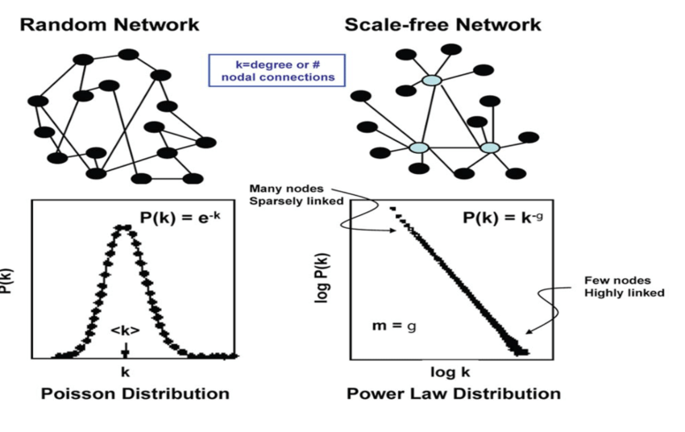
Scale-free networks vs Random-Networks representation
Random Networks:
Networks are generated randomly
HUBS are not presents
Few nodes have low and very high degree
Scale-Free Networks:
Allows HUBS
Few nodes have an higher degree, while lot of nodes have a lower degree
Scale-Free Networks model can better approximate real world scenarios

Slide 34
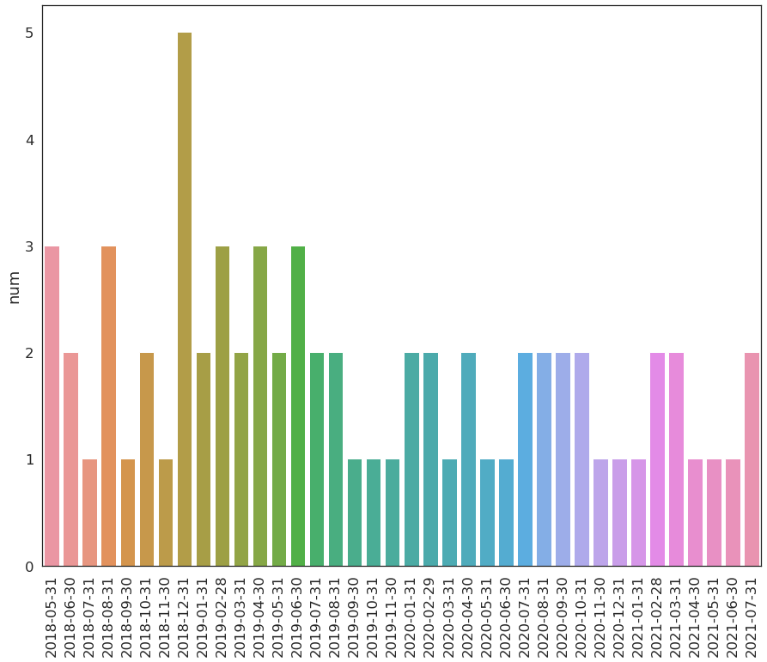
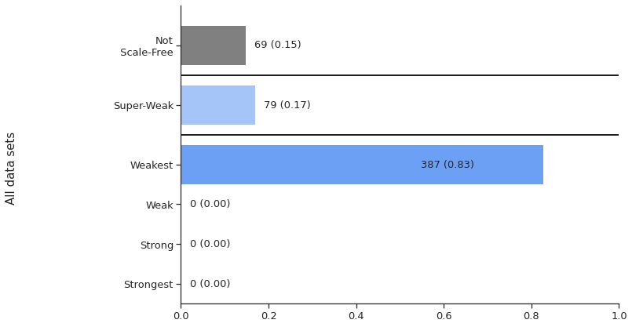
Scale-free networks detection - cumulative
Networks in the system are mostly Weakest Scale-free: 387
Super-Weak Scale-free Networks comprehend a tiny part of the population: 79
There are also Networks that are not Scale-free: 69
As time passing, networks are getting bigger and seem to present more a scale-free behavior.

Slide 35
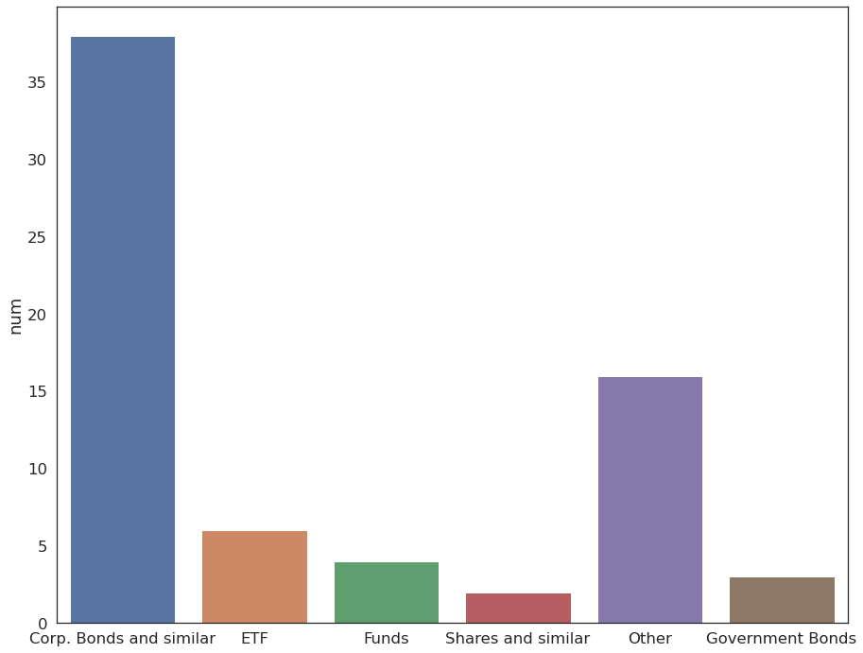
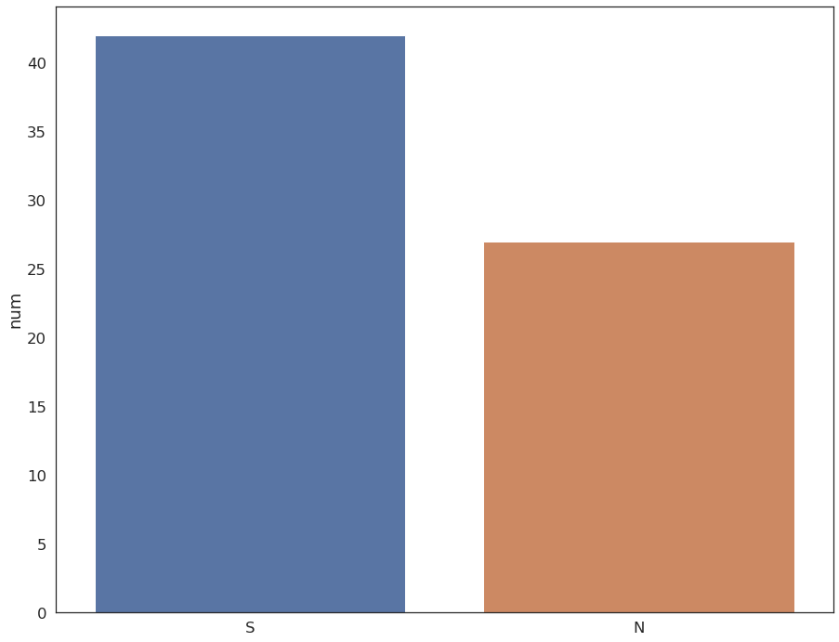
Scale-free networks detection - cumulative
Scale free behavior is not present mostly in Corp. Bonds and Other Networks.
Scale free behavior is not present mostly in Networks Settled status.

Slide 36
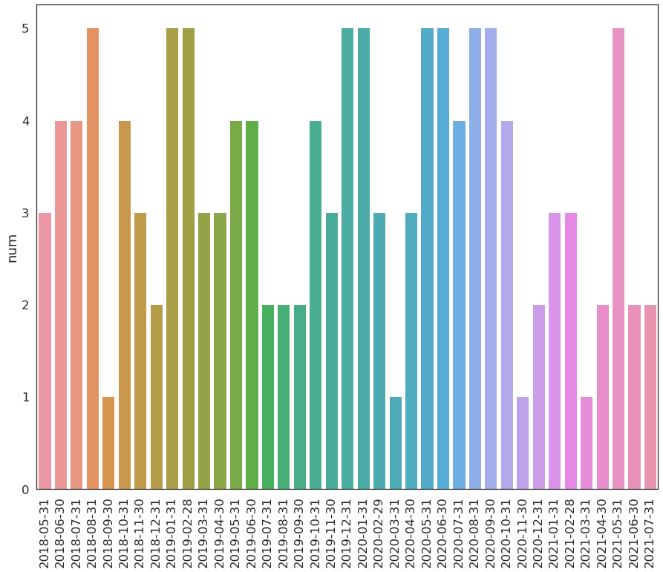
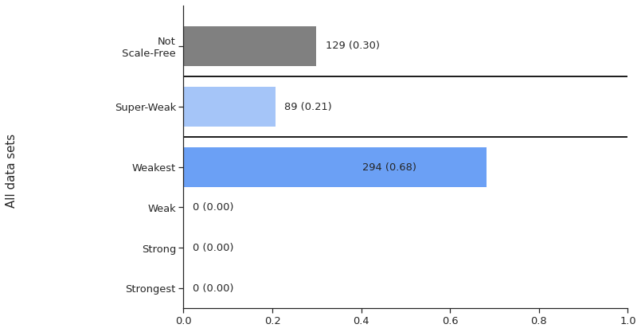
Scale-free networks detection - monthly
Networks in the system are mostly Weakest Scale-free: 294
Super-Weak Scale-free Networks comprehend a tiny part of the population
There are also Networks that are not Scale-free: 129
Some months presents not scale-free behavior majorly

Slide 37
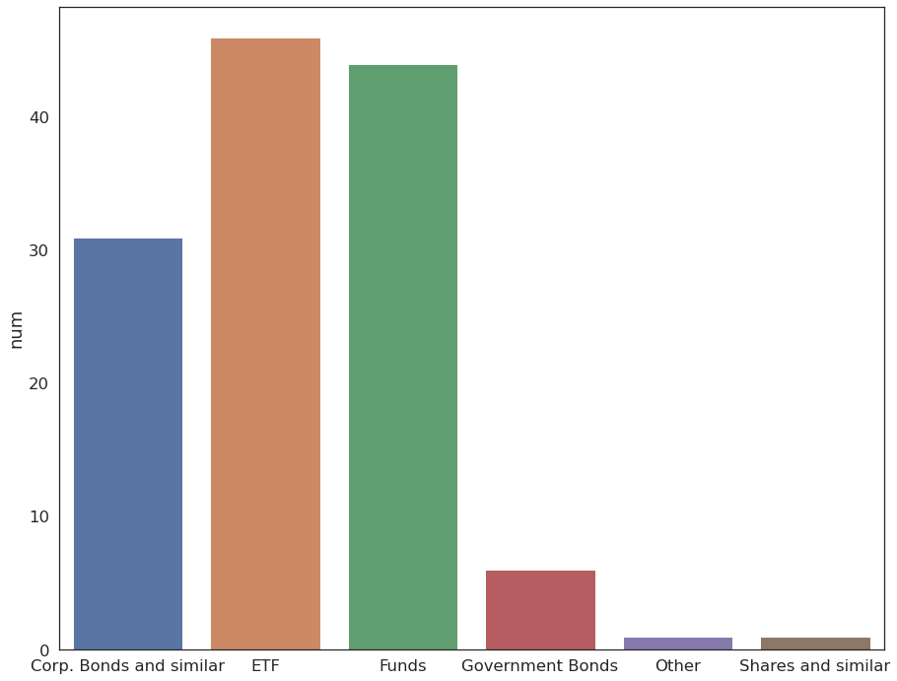
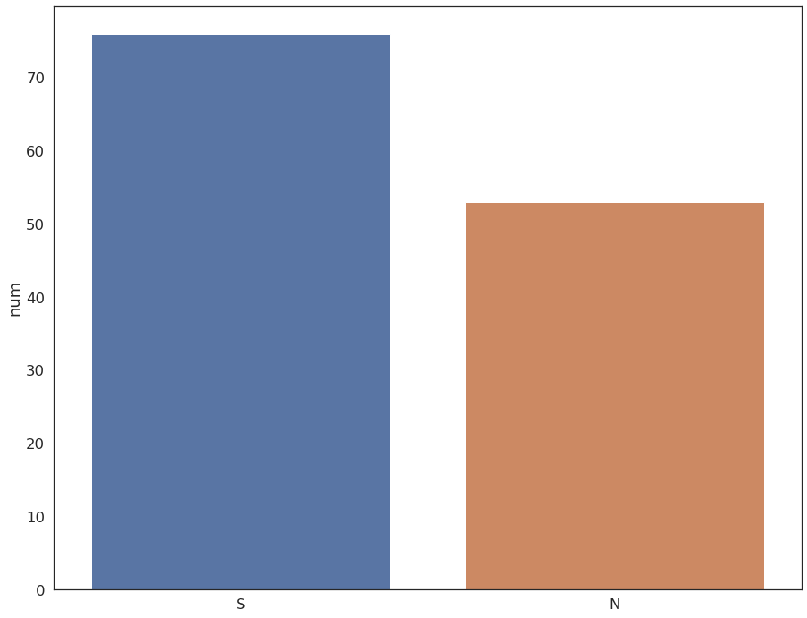
Scale-free networks detection - monthly
Scale free behavior is not present mostly in ETF, Funds and Corp. Bonds Networks.
Scale free behavior is not present mostly in Networks that are constructed with Instruction with status as Settled

Slide 38
Node Deletion
In a network a node deletion means that a Company may goes to bankrupt or most commonly the company decides to exit the system.
To verify the structure alterations, it is possible to detect any changes in the Connected Component (CC) of a Network:
If after a deletion, a change in the CCs is present, this means that the node is a vulnerable one and the Network has been damaged and compromised.
If after a deletion, there is no changes in the Connected Component, this implies that the networks has not been compromised.
Scale-free property strongly correlates with the network's robustness to failure:
The major hubs are closely followed by smaller ones. These smaller hubs, in turn, are followed by other nodes with an even smaller degree and so on.
Node deletion approaches are applied:
Random Node deletion: a node is deleted randomly form the Network
Localized Node deletion: a deletion of a precisely selected node

Slide 39
Node deletion importance - cumulative
Central nodes deletion may alter the structure of the network.
North Source, Monte Titoli and Building Application Innovation are the central nodes that in most cases, if deleted, would have damaged the network.

Slide 40
Node deletion importance - monthly
Central nodes deletion may alter the structure of the network.
North Source, Internet East Hardware and CC&G are the central nodes that in most cases, if deleted, damaged the network.

Slide 41
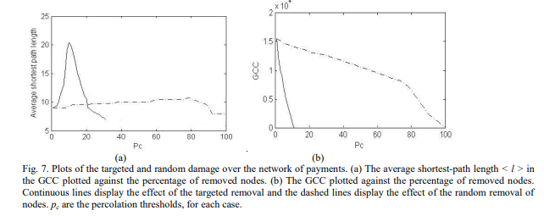
Node deletion importance - Literature
Paper: On the topologic structure of economic complex networks: empirical evidence from large scale payment network of Estonia,
Comparison of the node percentage when deleting Central node vs. random removal
For central nodes results in an initial increase of the Avg. shortest path length to finally decrease. Random deletion maintains the measure stable
For central nodes size of GCC is decreasing faster w.r.t. random nodes.
Stephanie Rendón de la Torre*, Jaan Kalda* , Robert Kitt*1, Jüri Engelbrecht* *Institute of Cybernetics at Tallinn University of Technology, Akadeemia tee 21, 12618, Tallinn, ESTONIA 1 Swedbank AS, Liivalaia 12, 15038, Tallinn, ESTONIA

Slide 42
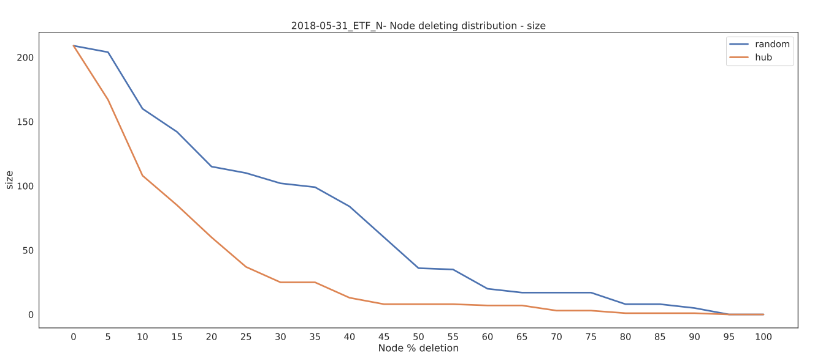
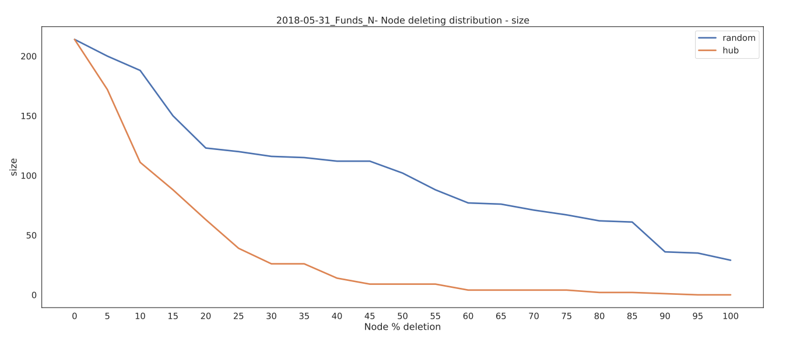
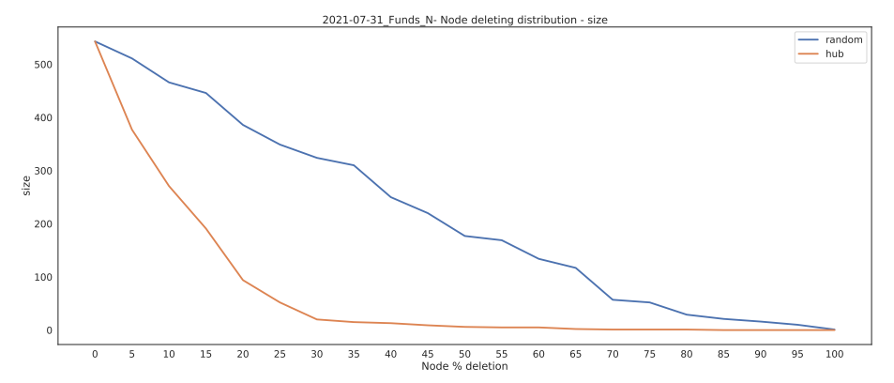
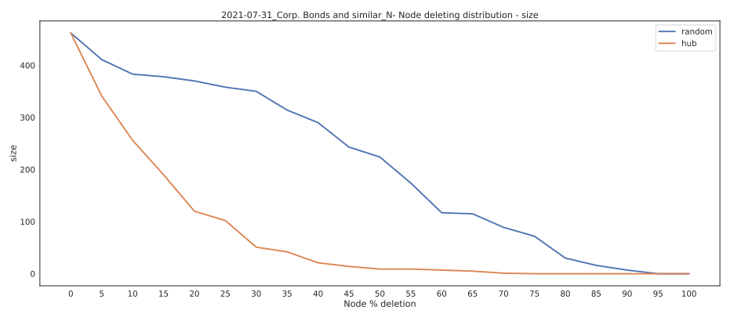
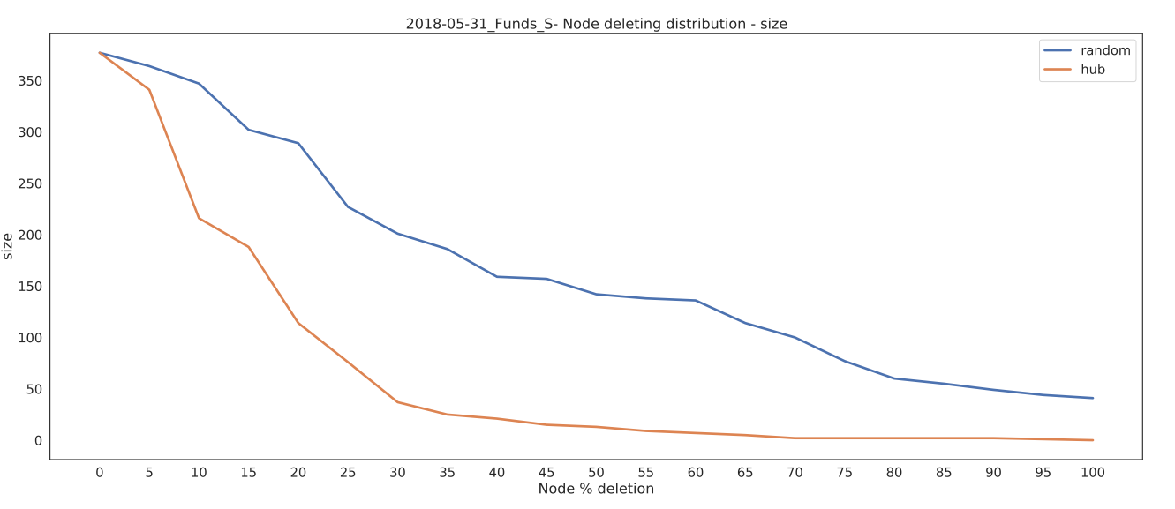
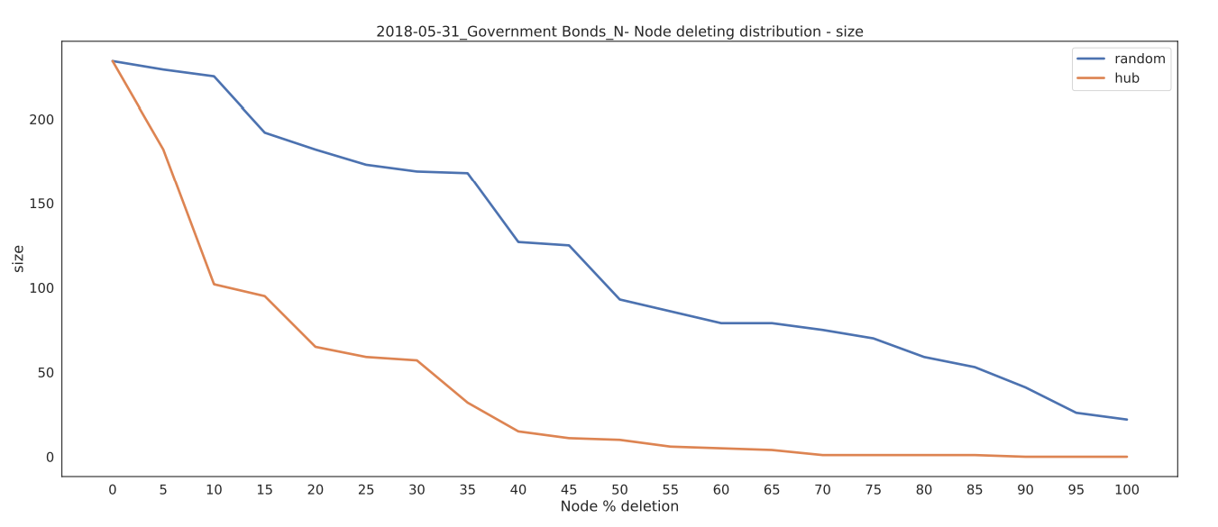
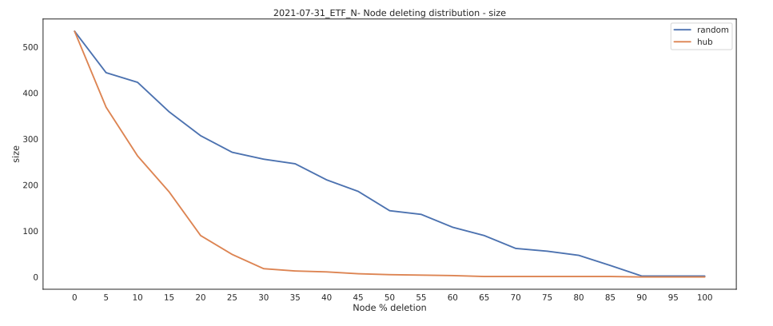
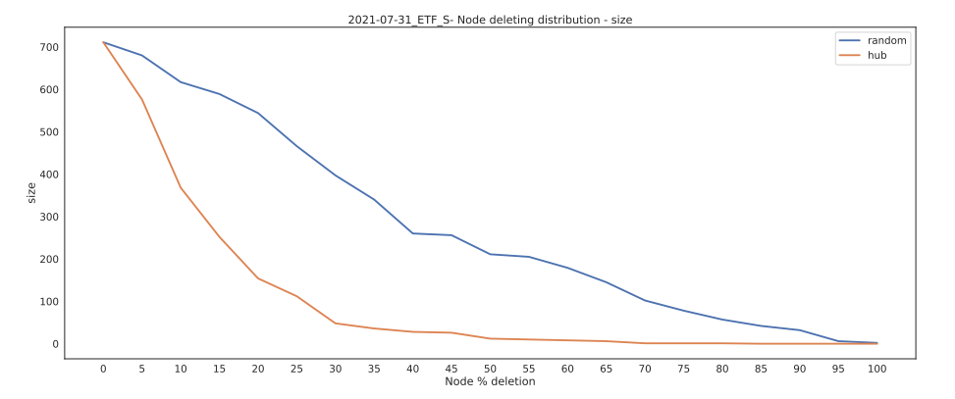
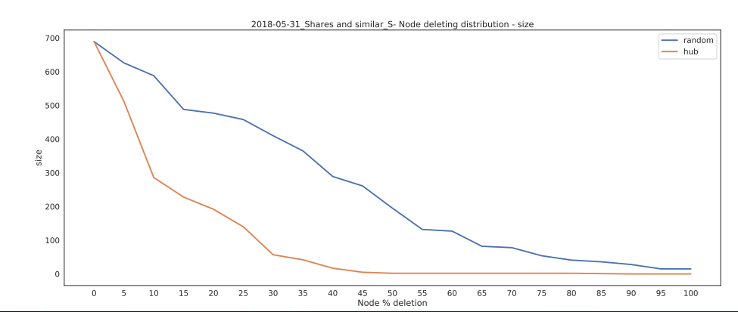
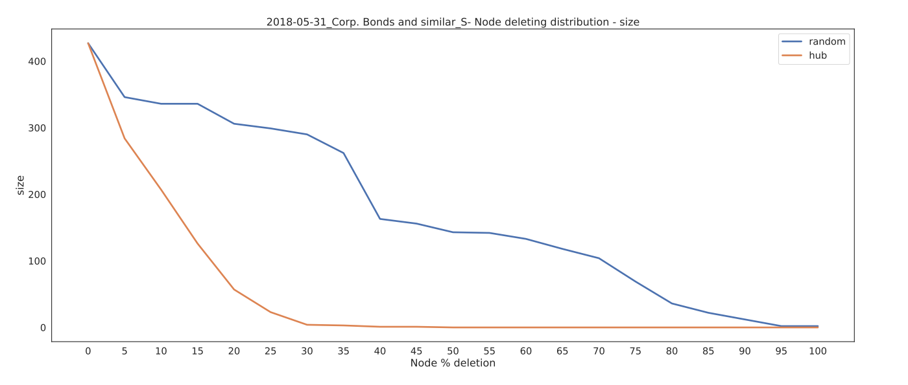
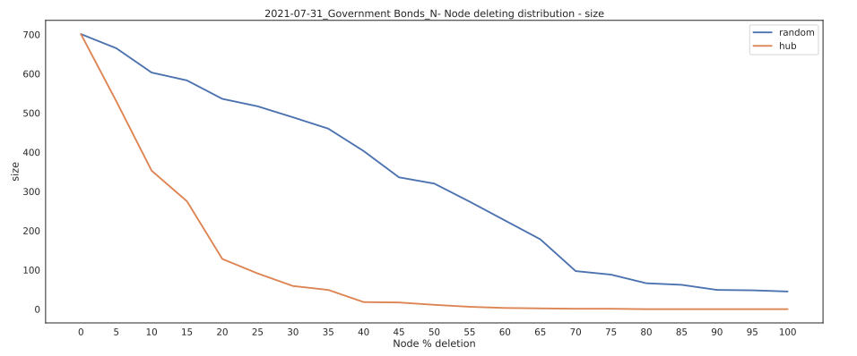
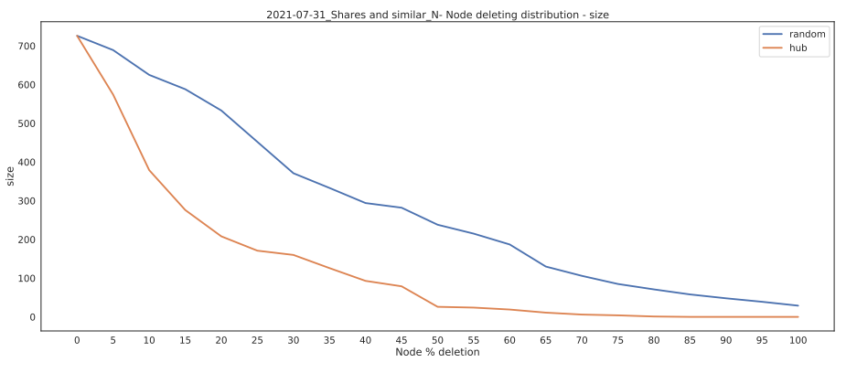
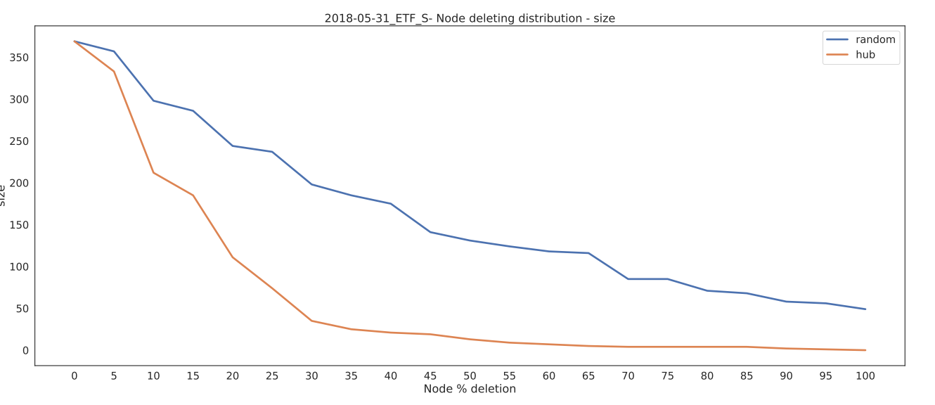
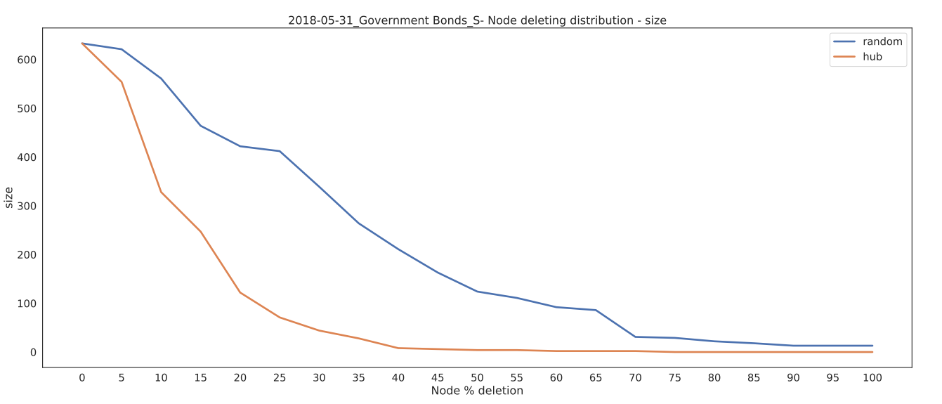
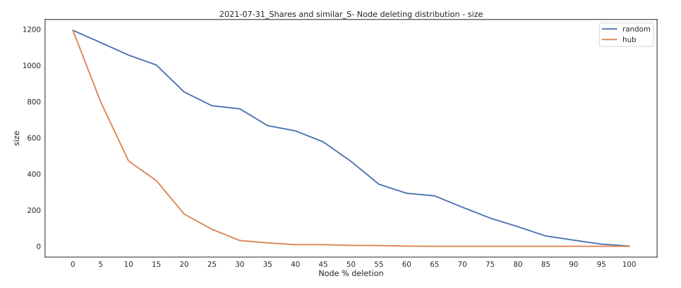
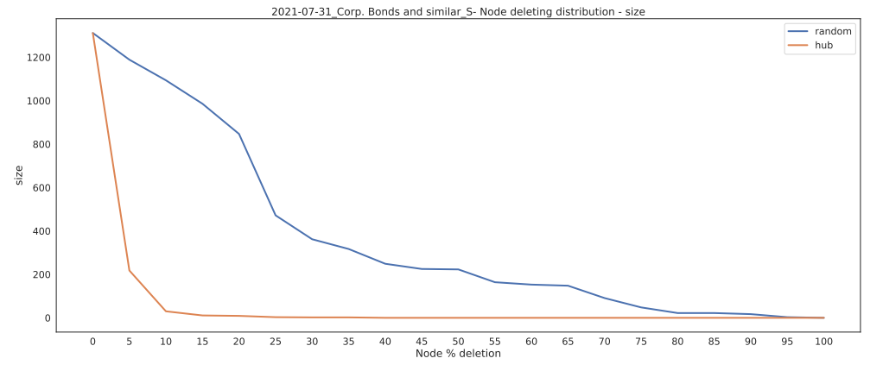
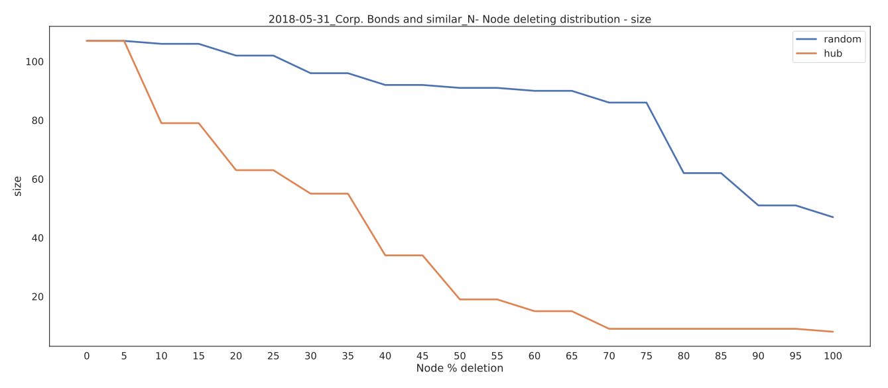
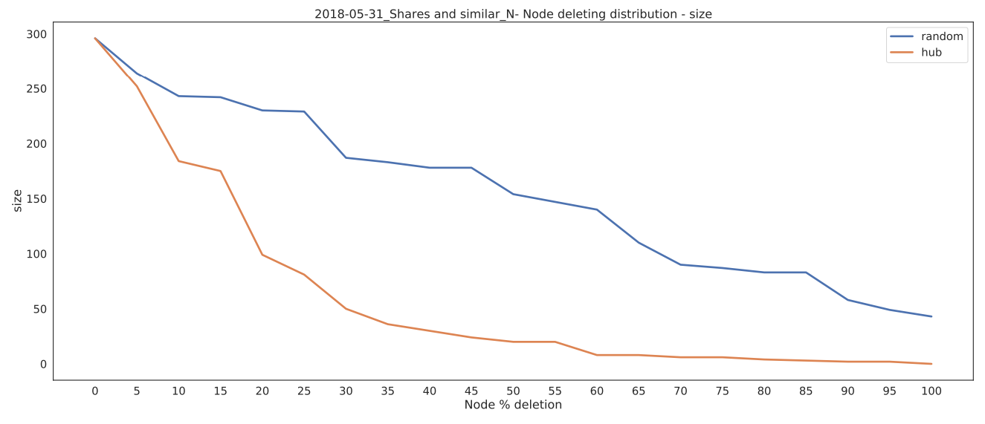
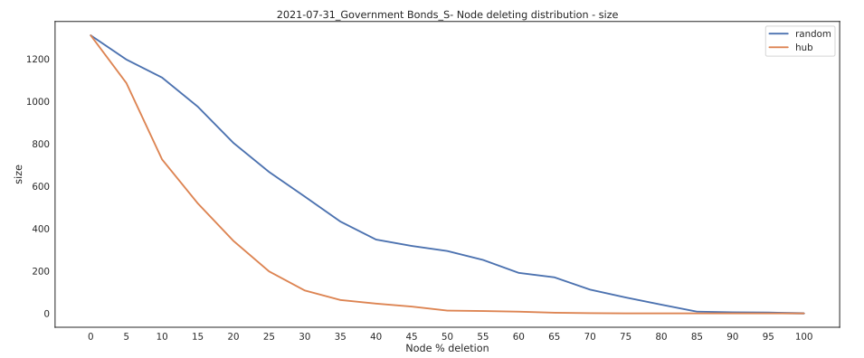
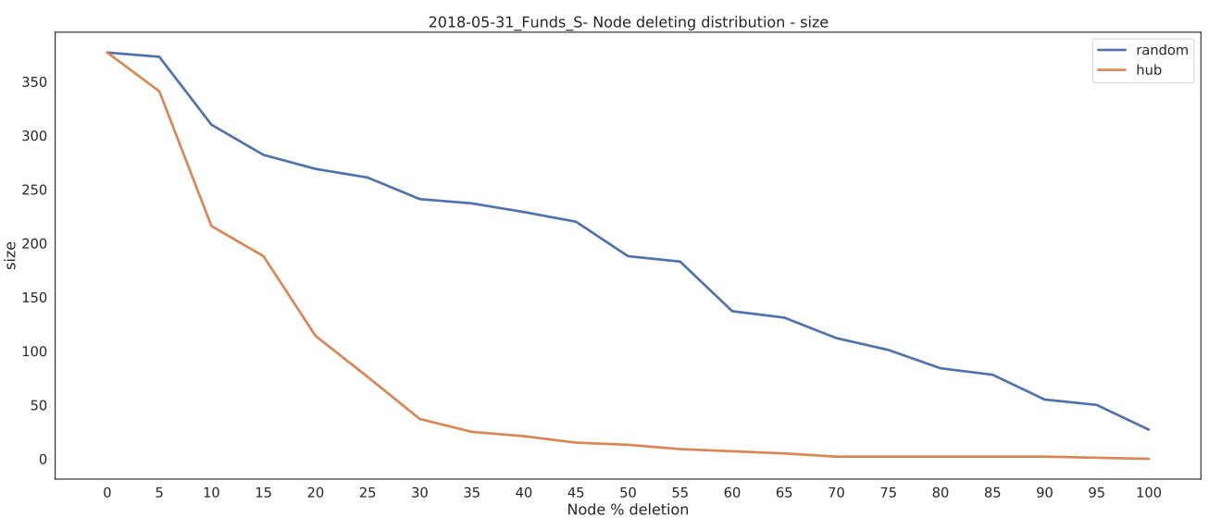
Central node Ranking – Cumulative vs non-cumulative

Slide 43
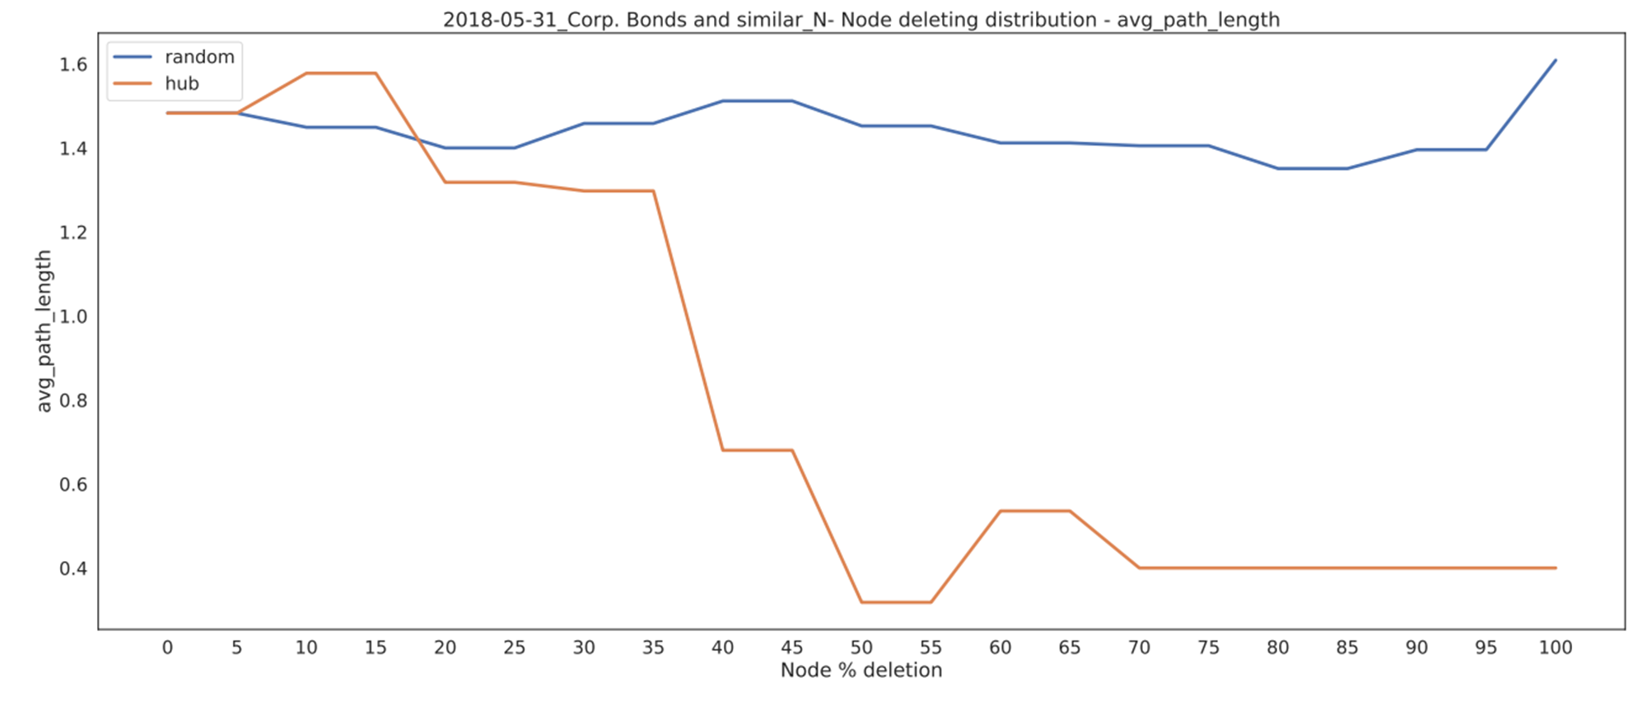
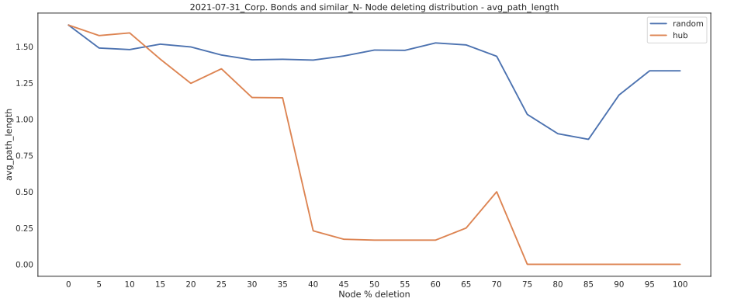
Central node Ranking – Cumulative vs non-cumulative
Corp. Bonds_N
Initial avg_path_length is increasing, i.e. distance between nodes when hub is deleted is increasing
After a little growing, the avg path is decreasing fastly
avg path in Random deletion is stable
Size of the connected component for Central nodes deletion is faster w.r.t. random deletion

Slide 44
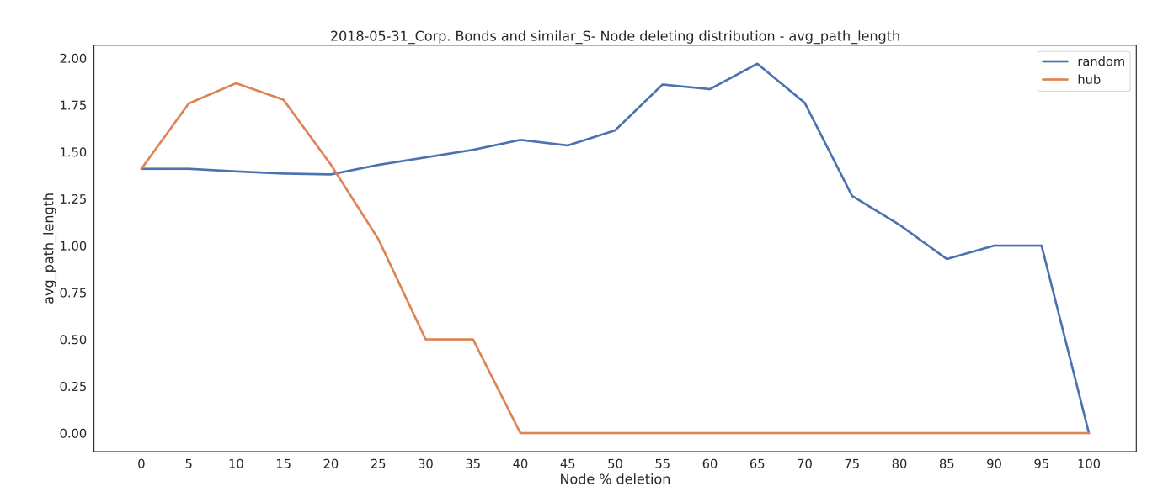
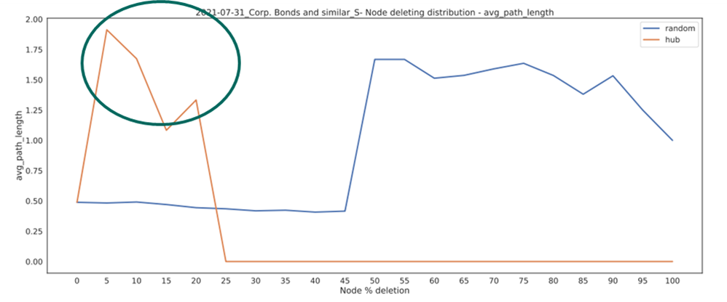
Central node Ranking – Cumulative vs non-cumulative
Corp. Bonds_S
Initial avg_path_length is increasing, i.e. distance between nodes when hub is deleted is increasing
After a little growing, the avg path is decreasing fastly
avg path in Random deletion is stable
Size of the connected component for Central nodes deletion is faster w.r.t. random deletion

Slide 45
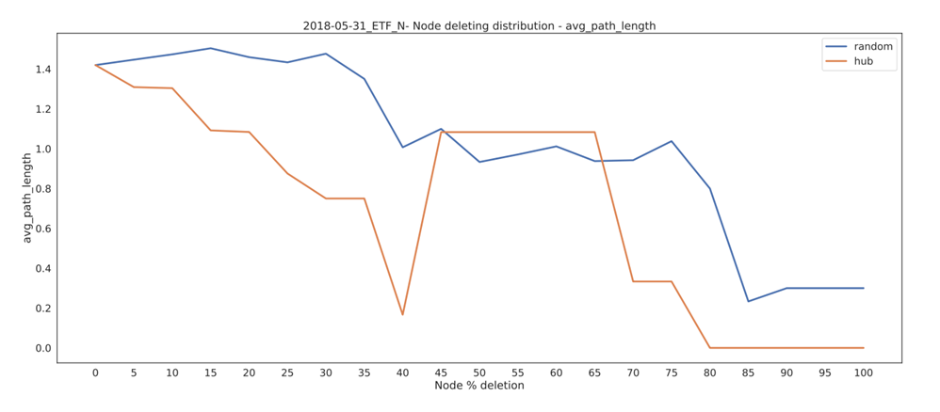
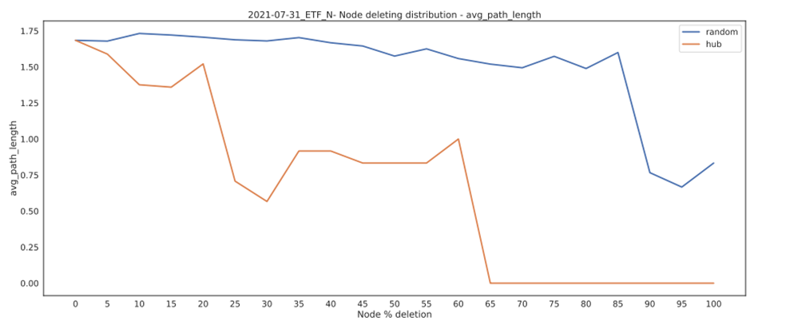
Central node Ranking – Cumulative vs non-cumulative
ETF_N
Initial avg_path_length is decreasing and after some node it increases
Similar as non-cumulative

Slide 46
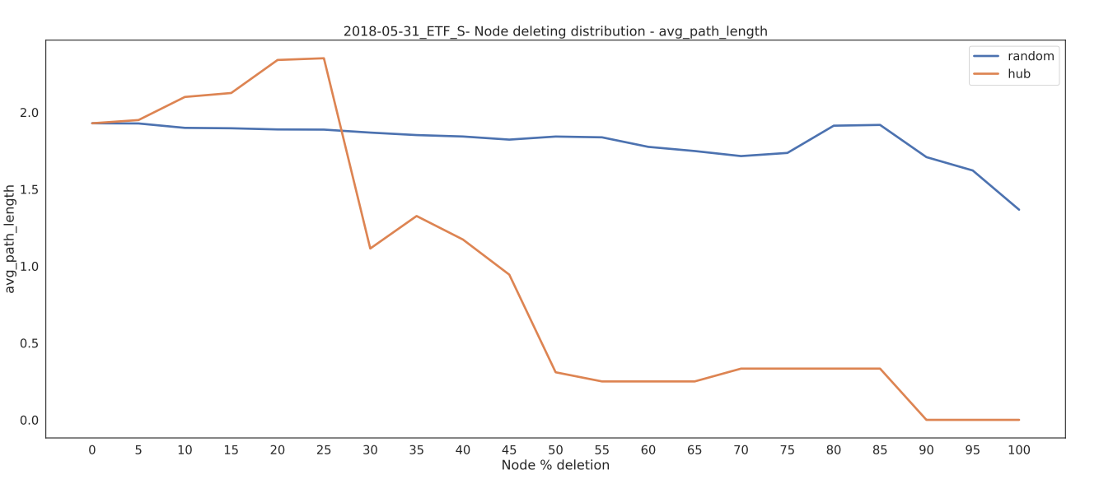
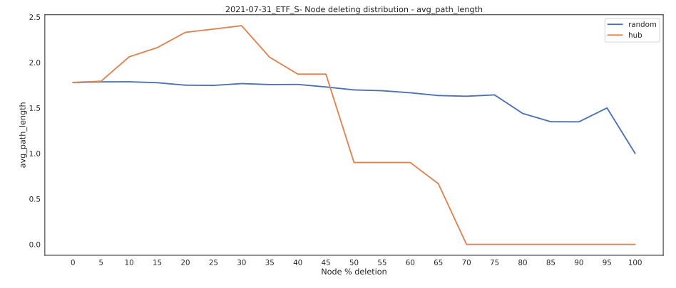
Central node Ranking – Cumulative vs non-cumulative
ETF_S

Slide 47
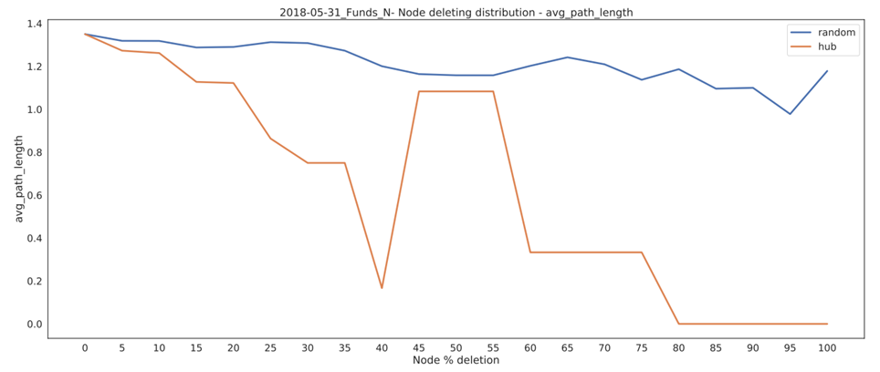

Central node Ranking – Cumulative vs non-cumulative
Funds_N

Slide 48


Central node Ranking – Cumulative vs non-cumulative

Slide 49


Central node Ranking – Cumulative vs non-cumulative

Slide 50


Central node Ranking – Cumulative vs non-cumulative

Slide 51

Central node Ranking – Cumulative vs non-cumulative

Slide 52


Central node Ranking – Cumulative vs non-cumulative

Slide 53
Daily Analysis
Two Case-Studies of disruptive events:
COVID19
BTP Italia and BTP futura emissions

Slide 54
Disruptive Events
Disruptive Events could reversely change the Network topology and structure.
Events such as the September 11th 2001 terrorist attack have shown how this event can alter economics systems. In this case the Financial systems of the USA have been disrupted.
Two different case-studies of disruptive events:
The impact of Covid19 on the network metrics and topology during the first lockdown:
Period from January 2020 to June 2020
The impact of large emission of BTP Italia and BTP Futura:
The analysis takes into consideration the next ten days after the BTP announcement.
This is considered a disruptive event since large amount of instructions are exchanged during the emission dates.

Slide 55
Case study: Covid 19 Effects
Impact of Covid19 on the network metrics and topology during the first lockdown
The idea is obtaining daily networks of 6 month before the first lockdown and compare the connection and the size of the networks over time
Dates: date are from 01-06-2019 to 01-06-2020
Before Covid19 period: 01-06-2019 to 31-12-2019
After Covid19 period: 01-01-2020 to 01-06-2020

Slide 56


Before and After Covid19 : Corp. Bonds and similar_N
Mean degree appears to decrease during the lockdown
Avg. shortest path length is unstable before Covid19 and then it is not computable:
The network is no more strongly and weakly connected
There are node that are isolated and a path length that tends to infinity

Slide 57


Before and After Covid19 : Corp. Bonds and similar_S
Mean degree appears to be stable over time before and after Covid19
Avg. shortest path length is stable over time

Slide 58


Before and After Covid19 : ETF_N
Mean degree appears to increase during the lockdown
Avg. shortest path length is unstable before and after Covid19.
There is a spike on April 2020

Slide 59

Before and After Covid19 : ETF_S
Mean degree appears to slightly increase during the lockdown
Avg. shortest path length is stable before and after Covid19

Slide 60


Before and After Covid19 : Funds_N
Mean degree appears to increase during the lockdown
Avg. shortest path length is unstable before and after Covid19
Spike in April 2020

Slide 61
Before and After Covid19 : Funds_S
Mean degree appears to slightly increase during the lockdown
Avg. shortest path length is stable before and after Covid19

Slide 62


Before and After Covid19 : Government Bonds_N
Mean degree appears to increase during the lockdown
Avg. shortest path length decreased on April 2020, but then it increases after Covid

Slide 63


Before and After Covid19 : Government Bonds_S
Mean degree appears to increase during the lockdown but also before the lockdown
Avg. shortest path length is unstable before and after Covid

Slide 64


Before and After Covid19 : Shares and similar_N
Mean degree appears to increase during the lockdown
In this case we have not information about the shortest path length, this is due to the fact that the graph is not totally connected
There are companies that are isolated (usually self loops)

Slide 65


Before and After Covid19 : Shares and similar_S
Mean degree appears is stable
Avg. shortest path length is stable before and after Covid19

Slide 66
Trend Mean degree average for Settle and Unsettle instructions
Overal trend is decreasing during Covid19
Assortativity before Covid19 is increasing, while during Covid19 increase slowly

Slide 67
Trend Mean degree average for Settle and Unsettle instructions
Mean degree is decreasing after COVID19 for Settle instruction
Mean degree is decreasing after COVID19 for Unsettle instructions

Slide 68
Trend Assortativity averaged for Settle and Unsettle instructions
Assortativity is slightly increasing before, and during COVID19 is stable for Settle instructions
Assortativity is increasing before and during COVID19 is stable

Slide 69
BTP Italia and Futura emissions effect
The impact of large emission of Government Bonds such as BTP Italia and BTP Futura on the network metric and topology. The analysis takes into consideration the next ten days after the BTP announcement. This is considered a disruptive event since large amount of instructions are exchanged during the emission dates.
BTP Italia Emission dates:
From 14th to 17th May 2018
From 19th to 22nd November 2018
From 21st to 23rd October 2019
From 18th to 20th May 2021
BTP Futura Emission dates:
From 6th to 10th July 2020
From 09th to 13th November 2020
From 19th to 23rd April 2021

Slide 70


Before and After BTP Italia Emissions : May 2018 - Gov. Bonds_S
Mean degree during and after emissions is increasing
Avg. shortest path length is stable and after emission is decreasing

Slide 71


Before and After BTP Italia Emissions : May 2018 - Gov. Bonds_N
Mean degree is increasing during and after emissions
Avg. shortest path length during 2 dates of emission is not computable due isolates nodes

Slide 72

Before and After BTP Italia Emissions : Nov 2018 - Gov. Bonds_S
Mean degree during and after emissions is increasing
Avg. shortest path length is decreasing during emissions and increasing after

Slide 73


Before and After BTP Italia Emissions : Nov 2018 - Gov. Bonds_N
Mean degree during and after emissions is increasing
Avg. shortest path length is stable, during emission it decreases and after it increases

Slide 74


Before and After BTP Italia Emissions : Oct 2019 - Gov. Bonds_S
Mean degree is increasing during emissions
Avg. shortest path length has a decreasing trend

Slide 75


Before and After BTP Italia Emissions : Oct 2019 - Gov. Bonds_N
Mean degree during and after emissions is increasing
During Oct. 2019 we have networks with isolated nodes

Slide 76

Before and After BTP Italia Emissions : May 2021 - Gov. Bonds_S
Mean degree during emission is increasing, and after emissions is deacresing
Avg. shortest path length after emission is decreasing

Slide 77

Before and After BTP Italia Emissions : May 2021 - Gov. Bonds_N
Mean degree during emissions is decreasing and after is increasing
Avg. shortest path length during emissions is not computable

Slide 78


Before and After BTP Futura Emissions : Nov 2020 - Gov. Bonds_N
Mean degree during emissions is increasing
Avg. shortest path length is not computable before emission and then is decreasing after emission

Slide 79

Before and After BTP Futura Emissions : Nov 2020 - Gov. Bonds_S
Mean degree during emissions is decreasing
Avg. shortest path length is decreasing after emissions

Slide 80


Before and After BTP Futura Emissions : Jul 2020 - Gov. Bonds_N
Mean degree during and after emissions is increasing
Avg. shortest path length is increasing during emission and decreasing after

Slide 81


Before and After BTP Futura Emissions : Jul 2020 - Gov. Bonds_S
Mean degree is stable
Avg. shortest path length is unstable

Slide 82


Before and After BTP Futura Emissions : Apr 2021 - Gov. Bonds_N
Mean degree during and after emissions is increasing
Avg. shortest path length during emission is increasing and after decreasing (then we have disconnected components)

Slide 83


Before and After BTP Futura Emissions : Apr 2021 - Gov. Bonds_S
Mean degree during and after emissions is increasing
Avg. shortest path length is increasing during emission and decreasing after emissions

Slide 84
Conclusions and next steps

Slide 85
Conclusions
Monthly Analysis:
Definition of a ranking for the most central nodes help understanding which companies are the most important in the different type of financial instrument and Settlement status and also how they varied over time:
… are the most frequent central node in the different networks
Cumulative Network Central nodes are more stable according to the ranking
The identification over time of a Scale-free behaviour suggested that cumulative Networks are more prone to have a scale-free behaviour w.r.t. non-cumulative
Network of payments that have shown scale-free properties in literature are resilient to random damage. It is barely possible to destroy the network of payments by random removal, but if an exact portion of particularly selected nodes is removed, it breaks completely:
In most cases the elimination of Central nodes largely degenerate the network structures
In most cases, random removal of nodes do not affect the network structures largely
Daily Analysis:
COVID19 Case study demonstrates that it affected the networks in different ways:
Networks with Settled instruction appears to be the most affected: avg. shortest path in some cases is not computable
In most cases the mean degree after Covid19 has an increasing trend
BTP Italia and BTP Futura emissions:
Networks appears to be affected but without a certain rule

Slide 86

Thank You for Your Questions!

Slide 87
Degree analysis
Orders, sizes and degrees differs among all the different financial instrument types and instruction status
Each Company with type of instructions Government Bonds, Funds, Share and similar tend to exchange on average Settled Instruction with more than 20 other companies
Each Company with type of instructions ETF, Funds, Government Bonds and Share and similar tend on average to exchange Failed Instructions with more than 20 other companies
Order: Number of nodes
Size: Number of edges
Mean degree: average number of edges per node in the graph
Graph Type | Order | Size | Mean degree
Government Bonds_S | 72 | 1311 | 36.4
Funds_S | 67 | 754 | 22.5
Shares and similar_S | 114 | 1194 | 20.9
Other_S | 56 | 448 | 16.0
ETF_S | 419 | 2158 | 10.3
Corp. Bonds and similar_S | 346 | 1312 | 7.5
ETF_N | 68 | 1087 | 31.9
Shares and similar_N | 60 | 726 | 24.2
Government Bonds_N | 61 | 701 | 22.9
Funds_N | 54 | 543 | 20.1
Corp. Bonds and similar_N | 55 | 462 | 16.8
Other_N | 30 | 125 | 8.3

Slide 88
Average clustering, Assortativity and Transitivity measures
Graph Type | Avg. Clustering Coeff. | Assortativity | Transitivity
Government Bonds_S | 0.70 | -0.51 | 0.53
Other_S | 0.64 | -0.41 | 0.51
Funds_S | 0.61 | -0.48 | 0.45
Shares and similar_S | 0.40 | -0.50 | 0.53
ETF_S | 0.13 | -0.57 | 0.19
Corp. Bonds and similar_S | 0.12 | -0.67 | 0.12
Funds_N | 0.75 | -0.49 | 0.36
ETF_N | 0.75 | -0.47 | 0.47
Government Bonds_N | 0.73 | -0.55 | 0.38
Shares and similar_N | 0.73 | -0.47 | 0.45
Corp. Bonds and similar_N | 0.68 | -0.41 | 0.37
Other_N | 0.43 | -0.23 | 0.37
Average Clustering Coefficient is high in Settled and Failed Instructions:
Companies tend to exchange a lot of instructions with each other
Only in ETF and Corp. Bonds, companies NOT exchange much Settled instructions with each other
Assortativity is around -0.5 which means instructions tend to fail/settle more between companies that are not similar
Transitivity measure imply companies tends to deliver fail/settle instructions in triplets
Average Clustering: degree measure of how nodes tend to be connected to each other
Assortativity: preference for a network's nodes to attach to others that are similar
Transitivity: ratio between the observed number of closed triplets and the maximum possible number of closed triplets

Slide 89

Communities on Failed ETF
Performance: number of intra-community edges plus inter-community non-edges divided by the total number of potential edges.
Coverage: ratio of the number of intra-community edges to the total number of edges in the graph.
Modularity: measures the strength of division of a network into modules
Type | Performance | Coverage | Modularity
Walktrap | 0.58 | 0.74 | 0.03
Louvain | 0.52 | 0.97 | -0.0002
Leading Eigenvector | 0.51 | 0.61 | 0.10
Components | 0.40 | 0.99 | -0.000014
Label Propagation | 0.29 | 0.99 | 0.00
Infomap | 0.23 | 1.00 | 0.00
Walktrap and Louvain algorithms appears to be the best in detecting community (for ETF):
Performance and coverage rate are higher than 0.5
They detect more than 10 clusters
Leading Eivengvector detects two high populated clusters (performance and Coverage >0.5)
Label Propagation and Infomap performed poorly in detecting communities:
Infomap detected only one cluster and Label Propagation three clusters

Slide 90

ETF Failed instructions – Scale free example
Empirical Cumulative Distribution Function
Blue Line is the log log ECDF of ETF Network
Orange line is the log log ECDF of a Random Network
Red Line is the log log ECDF plot of a generated Scale-Free network with the same number of nodes of ETF Network
ECDF: Distribution of how much % of nodes with a certain degree
In this example: As the degree increase, the % of nodes with degree higher than 100 is decay slowly to 0
% of nodes
Considering the ECDF plot, ETF graph could be approximate to a Scale-free Network:
ETF and SF has a similar shape distribution (ECDF representation helps on identifying it)
ETF point distribution are more concentrated in the “center” as in SF Network

Slide 91
Conclusions and next steps

Slide 92
Conclusions
Degree Analysis:
Companies exchange a great number of instructions with each other (except Settled Instructions in ETF and Corp. Bonds)
Instructions fail/settle more between companies that are not similar
HUBS can help understanding what are the Companies that tend to receive or deliver more failing/settled instructions
Community Detection:
Walktrap and Louvain algorithms appears to be the best in detecting community
Although performance results are high, modularity score is low (i.e. strength of division of a network is low)
Scale-free Networks:
Knowing the distribution of Failed/Settled instruction may help identify patterns
Understanding if Networks is SL may help defining how future companies will exchange instructions
HUBS play an important role: new companies will majorly exchange with HUBS

Slide 93
Next Steps
Degree Analysis:
Build networks without considering countervalue as weight and considering the “free of payments” instructions
Identify new strategy for HUBS detection
Community Detection:
Ensemble of community detection algorithm
Scale-free Networks:
Explore more in depth the Scale-free behavior also for other type of market instruction to identify patterns
Define a solid methodology for detecting if Networks is Scale-free or not
Define how much a Network is SL: No scale-free, Weakest, Super Weak, Weak, Strong and Strongest

